Slide 1

Trend Analysis
LaShay Fontenot ● Ian Hatfield ● Ananya Garg ● Jayant Raisinghani
Data Analytics Programming
Aug 2019

Slide 2
Agenda
01
02
Context
Approach
03
04
Analysis
Conclusions

Slide 3
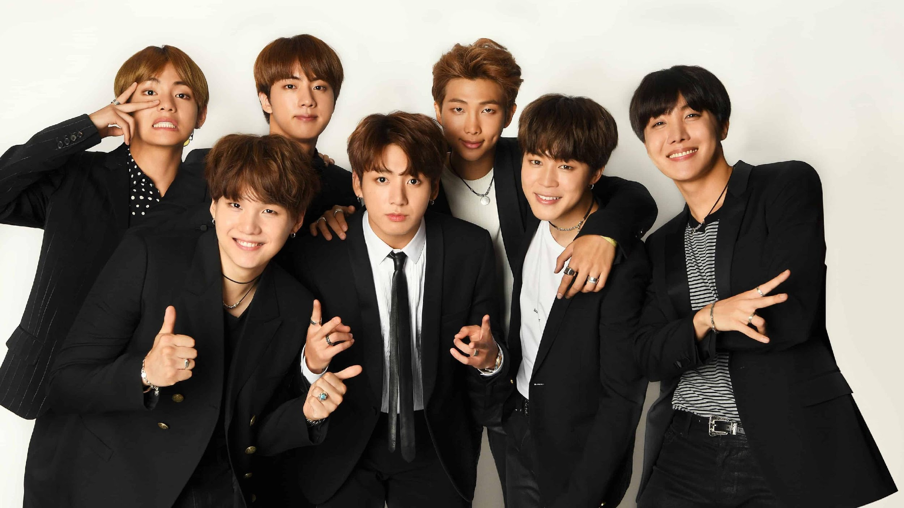
BTS
10 BILLION VIEWS

Slide 4




Situation
The boom of social media and original content has created a multi-billion dollar industry
$8B
Our analysis focuses on trending YouTube videos and their characteristics to answer three key questions when an influencer is trying to get into the influencer scene:
What content will maximize views in my country?
What is the best time to post my video?
What tags will get my video trending fastest?
Business Insider: The 2019 Influencer Marketing Report (July 15, 2019)

Slide 5

Approach
160,000 videos from four countries were cleansed and manipulated for this analysis
Variables
Video ID
Channel Title
Title
Publish Time
Trending Date
Category ID
Tags
Views
Likes & Dislikes
Comments
Data Cleansing
Map Category ID # to appropriate Category (e.g. movies, music)
Split Publish Time into Date, Time, and Hours
Create Time to Trending variable using publish time and trending date
Split Tags and Titles for text analysis & recommendation engine

Slide 6

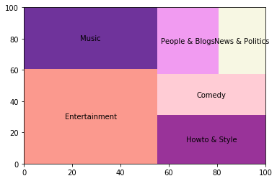
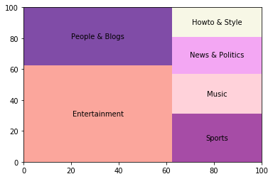
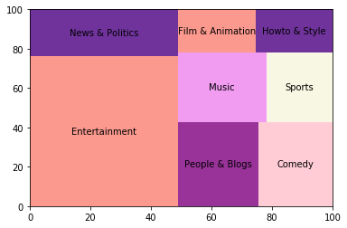
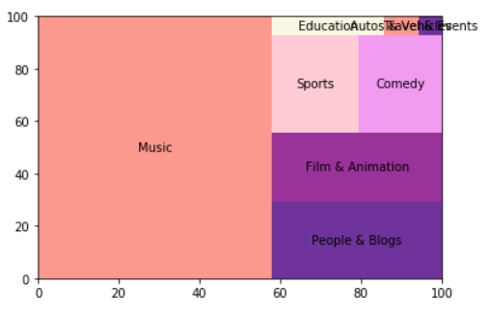
Category Analysis
USA
Mexico
Views =
Takeaways
Use views as a proxy for popularity
Entertainment & Music videos receive the most views on average
Great Britain has education in its top categories
Influencer categories (People & Blogs, How To) are top 2 or 3 in all countries
Canada
Great Britain

Slide 7
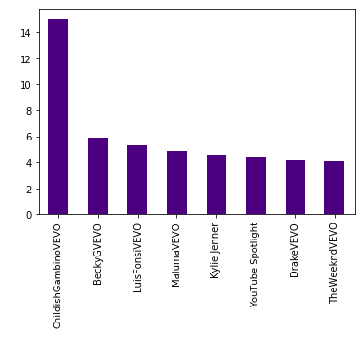
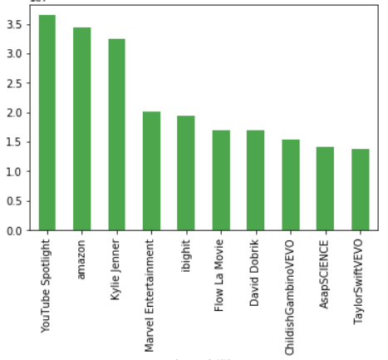
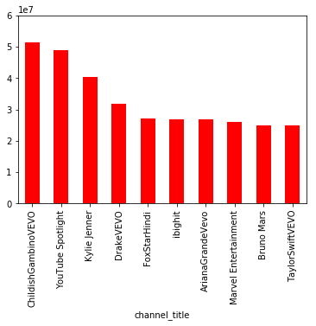
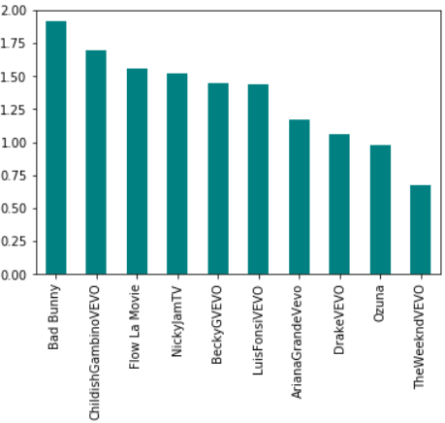
Channel Analysis
What are the most popular channels in each country?
USA
Mexico
Canada
Great Britain
Views in 10s of millions
The average views of the most popular channel is higher in the US by a factor of 7 compared to GB
Latin music and superheroes are common threads across countries
What does this mean for aspiring influencers? If you’re name is not Childish Gambino, Drake, or Kylie Jenner - goodluck!

Slide 8
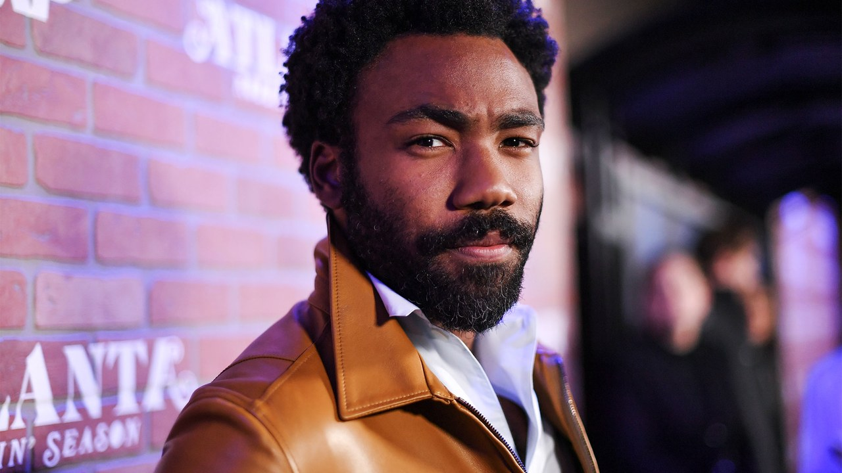
YEAH DONALD,
YOU WIN THE
LAST ROUND

Slide 9
Time to Trending Analysis
What content trends the quickest in each country?
 |  |  | Top 20 Time to Trending (in Days)
Country | Category | Notable Channel | 1 | 2 | 3 | 4 | 5 | 6 | 7 | 8 | 9
USA | Nonprofits and Activism | Bill Gates
 | Autos and Vehicles | Doug DeMuro
Mexico | Pets & Animals | The View
 | Music | Official Arctic Monkeys
Canada | Sports | CanucksHub
 | Science & Tech | i Justine
Great Britain | Music | SMTOWN
 | Comedy | Superwoman
Notes:
CanucksHub not even official
Call out The View being so American and trending in Mexico
Artic Monkeys take really long to trend
Everyone waits for Bill Gates to post
American comedy shows are posted at 3 am for Great Britain, and take the longest to trend there

Slide 10
Publish Time
What time should I publish my video?
USA
Mexico
Canada
Great Britain
11:00 PM
9:00 PM
5:00 PM
12:00 PM
USA should reduce the no. of videos it uploads at 4:00 PM, they take 2 days to trend
Take a note, y’all vloggers and influencers!
While 2AM was the most popular posting time, videos posted at 9 PM had the shortest time to trending on average
Videos posted at 5 PM trend the quickest - 1 day and 2 hours
These are typically comedy videos
Videos posted from 12-1 PM tend to trend the quickest
The top category videos are generally posted around this hour as well
Night owls in the USA and Mexico have the upper hand, while Canada and Great Britain reaches their audiences on the go (lunch and rush hour)
Notes:
localized data for regions of the country rather than just country data (cover many timezones)

Slide 11
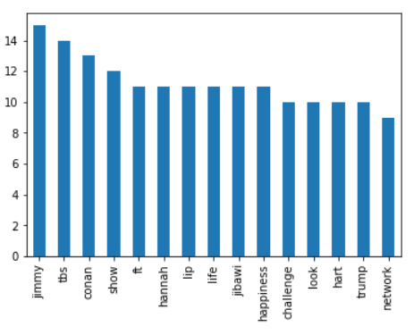
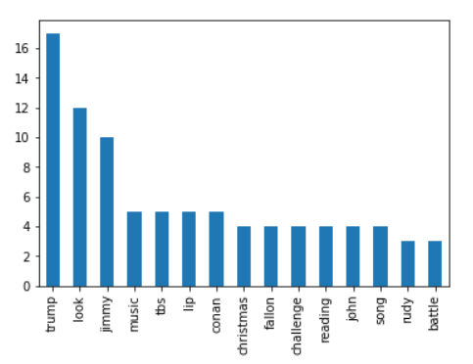
Additional Analysis
Can we recommend what words a youtuber needs to put to make his video trending?
By using string functions and POS tagging techniques, you can get a picture of what content people like watching in different regions
Comedy Titles
USA
Great Britain

Slide 12
Recommendation Engine
Example output for “makeup” search
What tags should I include in my video to ensure it reaches the right audience?
Split
Filter
Analyze
Output
Split tags and titles to create lists of words for each video
Filter video word lists to those matching the relevant categories and topics
Remove common words and unnecessary parts of speech (i.e. proper nouns) from lists
List of tag recommendations for your desired topic
Tags that will get your video in front of the right target audience are..

Slide 13
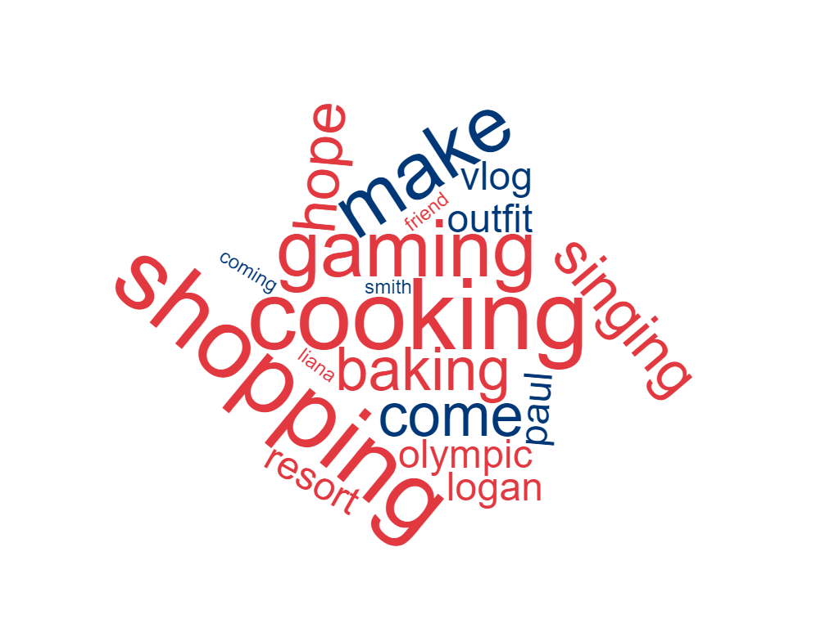
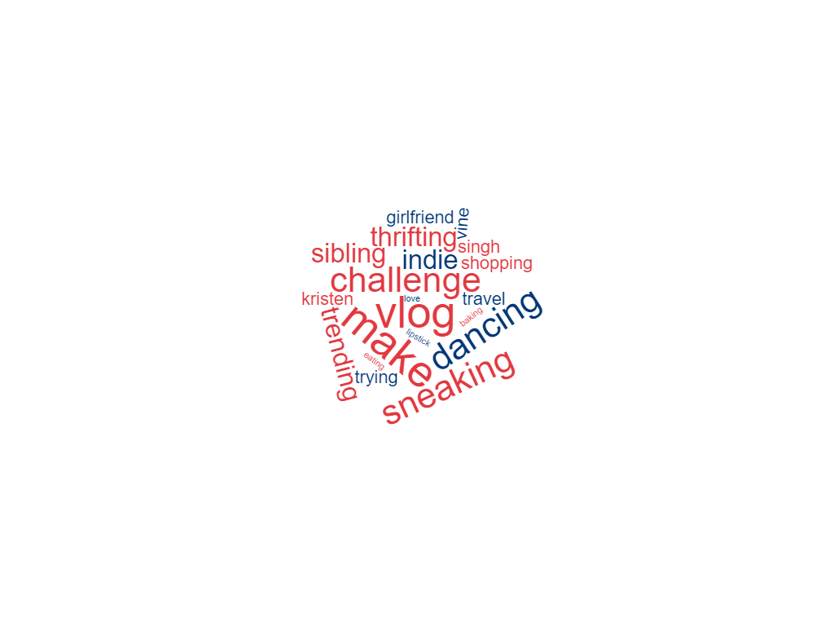
Vlogging Tags
Vloggers in the US and GB would be advised to use the following tags to reach their audiences
USA
Great Britain

Slide 14

Interesting Findings
GB
“America’s Got Talent” is one of the quickest channel titles to trend.
GB is also a huge fan of gaming, with lot of views and quicker trending times
CAN
While the popularity of Hockey videos is unsurprising, the avg. publish time of 6 am and fast time to trending is unintuitive.
USA
Auto and Vehicles is very popular here, with over 50 channels that regularly trend
MX
Music related channels struggle to go trending when compared to other countries.

Slide 15
Category
Channel
Conclusions
Although we cannot predict if / when your YouTube video will trend, we can give you the tools to tailor your content to appeal to the audiences in your country and maximize your view potential
The people love to be entertained and taught how to do things
Music artists own viewership on the site
Publish Time
Tags
Varies widely depending on where you are
Use our recommendation engine!

Slide 16
Considerations & Future Analysis
What are the common characteristics of the videos that do not make the trending list?
What are the most important factors at play in the YouTube trending algorithm?
Can we see and predict seasonality in trending categories and channels throughout the year?
How do trends compare across social media platforms? Do any lend themselves better to prediction models?

Slide 17
Question & Answer

